Slide 1
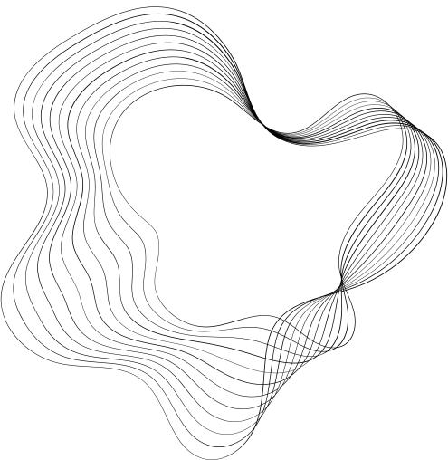

JPEG COMPRESSION
PIPELINE
TEAM MEMBERS:-
SHREEYA SINGHAL 21EC39032
SHREYA SAINATH DESAI 21EC39022

Slide 2

OBJECTIVE
The primary goal of JPEG compression is to minimize the storage space and bandwidth required for images.
We aim to explore how JPEG compression reduces file size, the trade-offs it makes, and the implications of these trade-offs on image quality.

Slide 3
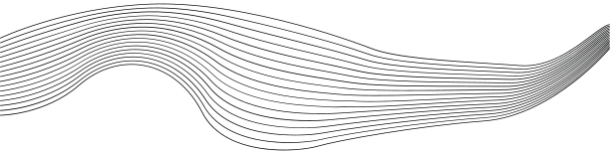
PIPELINE STAGES
01
Color space conversion
02
Sub-sampling
03
Discrete Cosine Transform (DCT)
04
Quantization
05
Run-length encoding (RLE)
06
Huffman coding

Slide 4

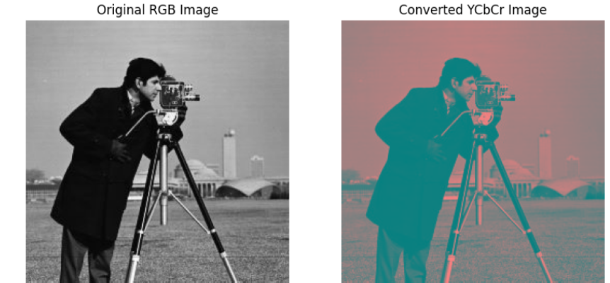
Colour Space Conversion(RGB to YCbCr)
This conversion is crucial because the human eye is more sensitive to changes in luminance (brightness) than in chrominance (color). The YCbCr model separates the luminance (Y) from the chrominance (Cb and Cr), allowing more aggressive compression of the color information.

Slide 5
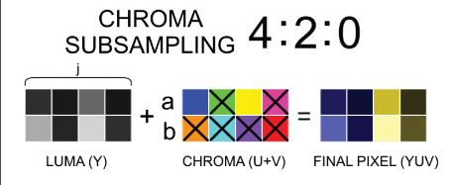
Sub Sampling
The 4:2:0 chroma subsampling method is used, which reduces the resolution of the chrominance channels by averaging color information within 2x2 pixel blocks. This downsampling leverages the human eye's lower sensitivity to color detail, enabling significant data reduction.

Slide 6
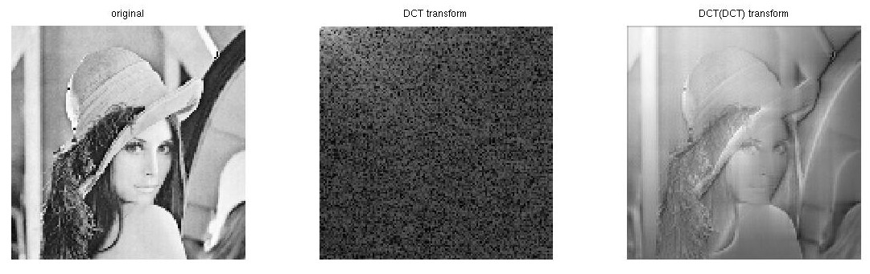
Discrete Cosine Transform
The DCT function carries out the Discrete Cosine Transform, which converts image data from the spatial domain to the frequency domain. This transformation helps to break down the image into components with varying levels of significance in terms of visual quality.

Slide 7
Quantization
The quantization functions perform quantization on the DCT coefficients, reducing the range of distinct values, especially for higher frequencies that have less impact on the image's overall appearance. The `LUM` and `CHR` arrays serve as quantization matrices for the luminance and chrominance channels, respectively.

Slide 8
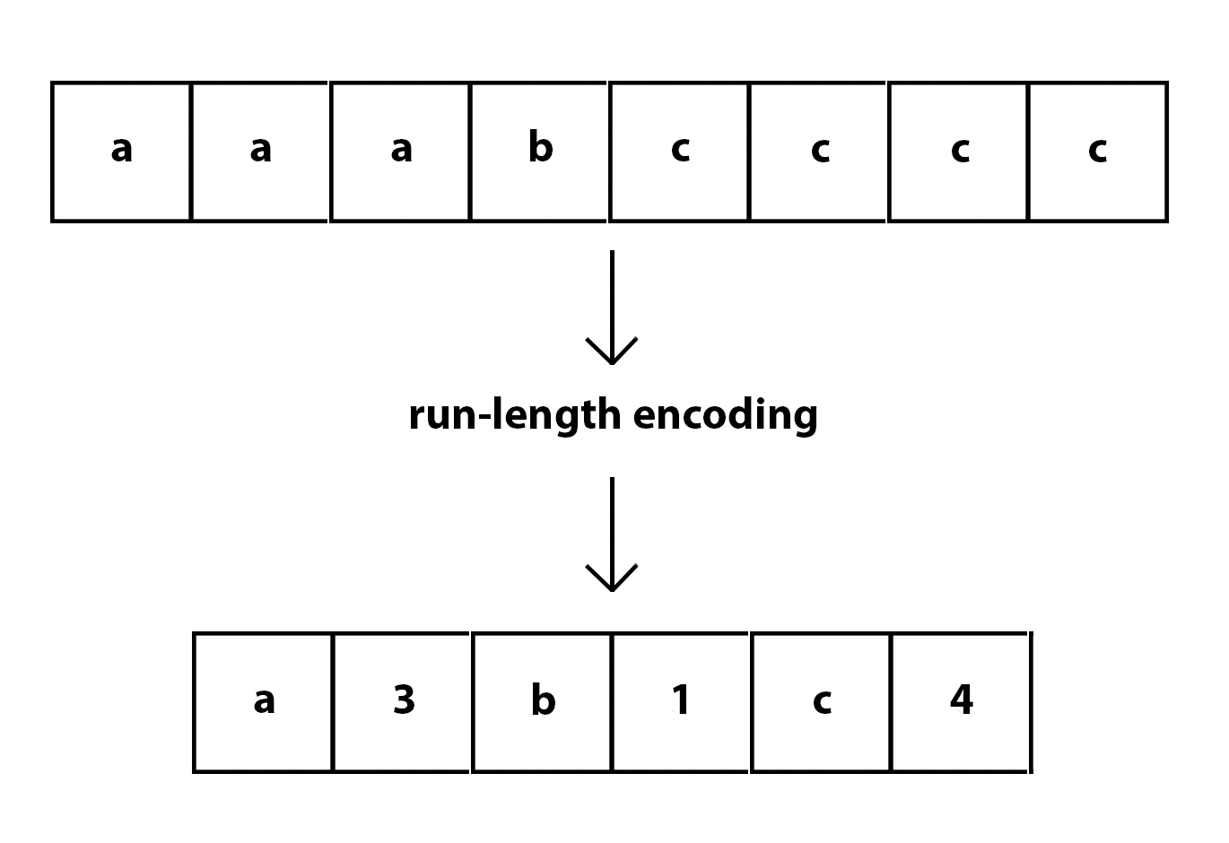
Run Length Encoding(RLE)
Following quantization, the we serialize the DCT coefficients in a zigzag pattern, prioritizing low-frequency components. The run length function then performs Run-Length Encoding on these coefficients, effectively compressing sequences of zeros that frequently appear in quantized blocks.

Slide 9
Huffman Coding
The Huffman coding process in this implementation uses entropy coding for lossless data compression. It assigns shorter binary codes to more common elements and longer codes to rarer ones, utilizing the frequency distribution derived from the image data.

Slide 10



Conclusion
Key Takeaways
The implementation demonstrates the core principles of JPEG compression, balancing file size reduction with image quality preservation.
JPEG effectively compresses data by utilizing the characteristics of human vision, reducing color detail while retaining important luminance information.
Compression Efficiency
By leveraging Discrete Cosine Transform (DCT), quantization, zigzag scanning, run-length encoding, and Huffman coding, the algorithm compresses image data significantly, achieving compression ratios of 14–16.
This multifaceted approach optimizes compression by focusing on essential visual information and eliminating redundancies.

Slide 11

THANKYOU

